Slide 1
Verification in BCNs
Use MCMAS

Slide 2
Guideline
Background
Definition of Boolean Network
Definition of Boolean Control Network
Four Observabilities of BCNs
Algebraic Forms of BCNs
Determine Observabilities by MCMAS

Slide 3
Background
In 1960s, Jacob and Monod found that “Any cell contains a number of ‘regulatory’ genes that act as switches and can turn one another on and off.... If genes can turn one another on and off, then you can have genetic circuits.”
Based on these Boolean-type actions in genetic circuits, Kauffman proposed using the Boolean network to describe the genetic circuits .

Slide 4
Definition of Boolean Network
A Boolean network is a graph
BN= (N, ε)
N is a finite set of nodes
ε ⊂ N×N is the edge set
A node can take a logic value from {0, 1} at a discrete time 0, 1, 2...
If A, B ∈ N and (A, B) ∈ ε ,then B ( k+1) depends on A (k).

Slide 5
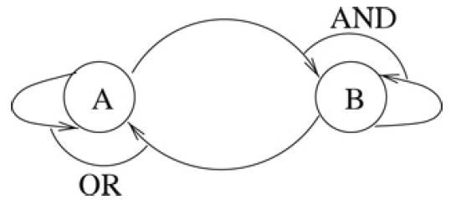
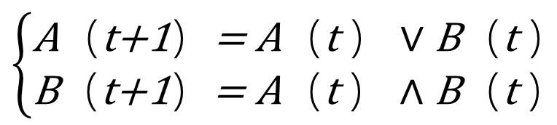
Definition of Boolean Network
For example
$$\left\{\begin{matrix}\text{A}（\text{t}\text{+1}）\text{=} \text{A}（\text{t} ）∨\text{B}（\text{t} ） \\ \text{B}（\text{t}\text{+1}）\text{=} \text{A}（\text{t} ）∧\text{B}（\text{t} ）\end{matrix}\right.$$

Slide 6
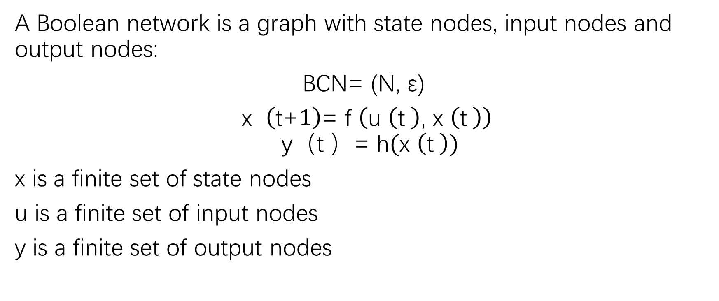
Definition of Boolean Control Network
A Boolean network is a graph with state nodes, input nodes and output nodes:
BCN= (N, ε)
$\text{x} （\text{t}\text{+}1）\text{=} \text{f} （\text{u} （\text{t} ）\text{, }\text{x} （\text{t} ））$
$$\text{y}（\text{t} ）\text{=} \text{h}(\text{x} \left(\text{t} \right))$$
x is a finite set of state nodes
u is a finite set of input nodes
y is a finite set of output nodes

Slide 7
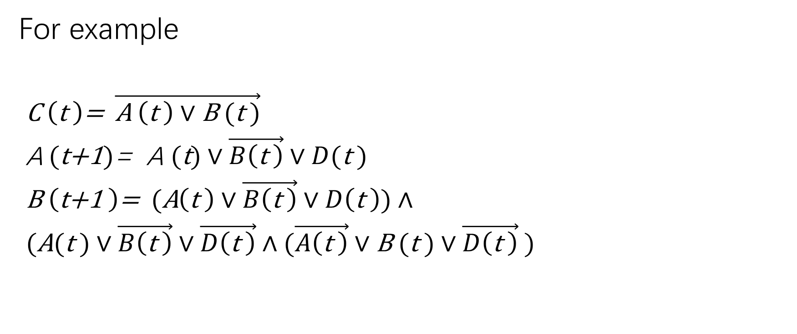
Definition of Boolean Control Network
For example
$\text{C} \left(\text{t} \right)\text{=} \vec{\text{A} \left(\text{t} \right)∨\text{B} (\text{t} )}$
$\text{A} (\text{t}\text{+1})\text{=} \text{A} (\text{t})∨\vec{B\left(\text{t} \right)}∨D(\text{t} )$
$\text{B} \left(\text{t}\text{+1} \right)\text{=} (\text{A}\left(\text{t} \right)∨\vec{B\left(\text{t} \right)}∨D\left(\text{t} \right))∧$
$(\text{A}(\text{t} )∨\vec{B\left(\text{t} \right)}∨\vec{D\left(\text{t} \right)}∧(\vec{A\left(\text{t} \right)}∨\text{B} (\text{t} )∨\vec{D\left(\text{t} \right)} )$
A
D
C
B

Slide 8
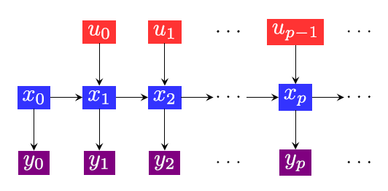
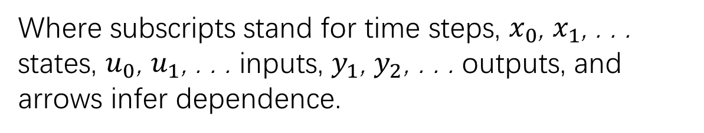
Definition of Boolean Control Network
The input-state-output-time transfer graph of BCN
Where subscripts stand for time steps, $x_{0}$, $x_{1}$, . . . states, $u_{0}$, $u_{1}$, . . . inputs, $y_{1}$, $y_{2}$, . . . outputs, and arrows infer dependence.

Slide 9
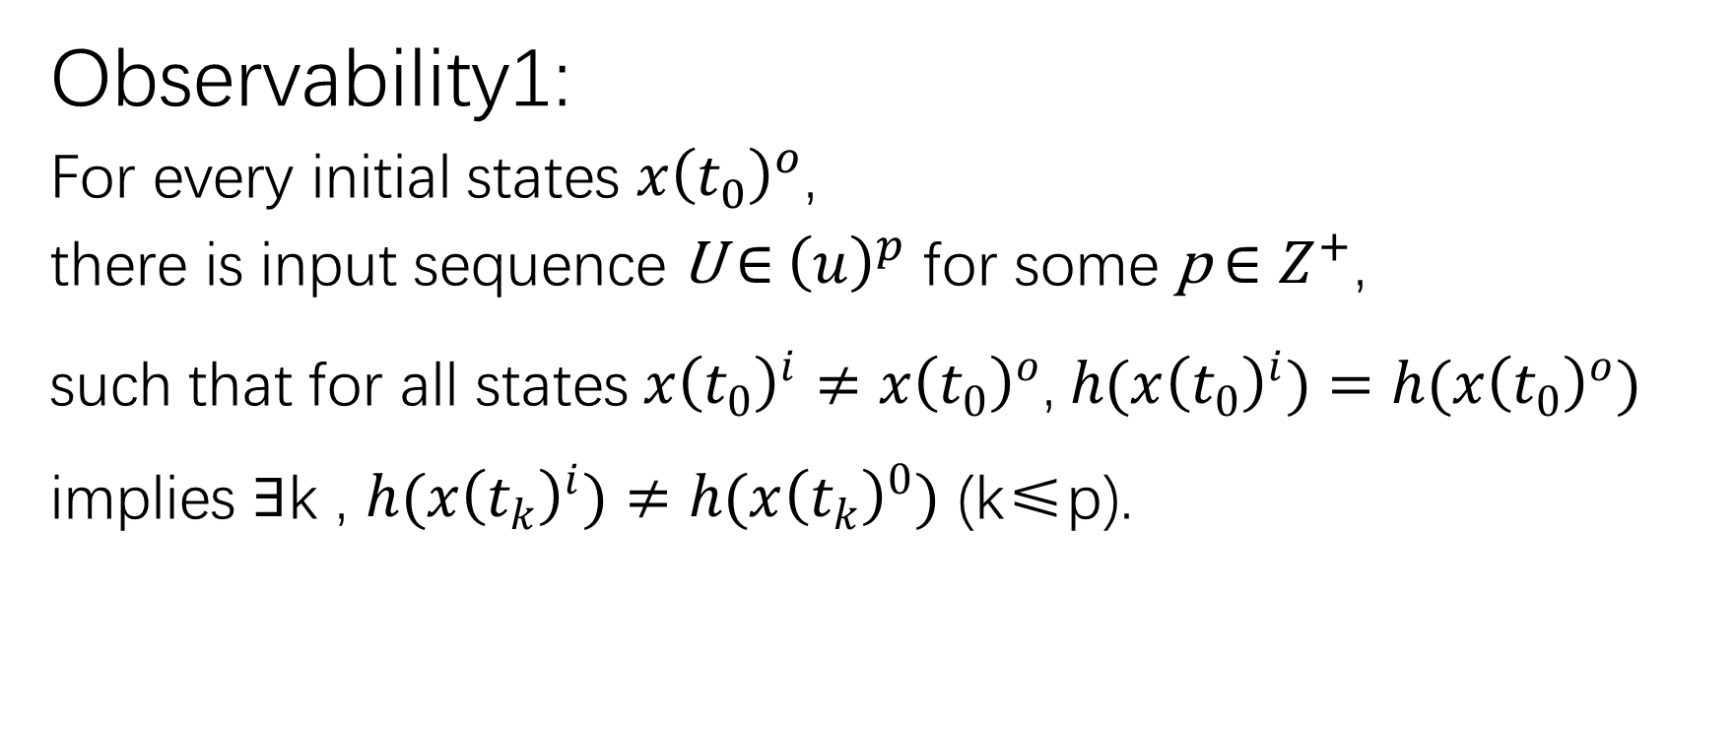
Four Observabilities of BCNs
Observability1:
For every initial states $x{\left(t_{0}\right)}^{o}$,
there is input sequence U$∈$ ${\left(u\right)}^{p}$ for some p $∈Z^{+}$,
such that for all states$x{\left(t_{0}\right)}^{i}≠x{\left(t_{0}\right)}^{o}$, $h(x{\left(t_{0}\right)}^{i})=h(x{\left(t_{0}\right)}^{o})$ implies $∃$k , $h(x{\left(t_{k}\right)}^{i})≠h(x{\left(t_{k}\right)}^{0})$ (k≤p).

Slide 10
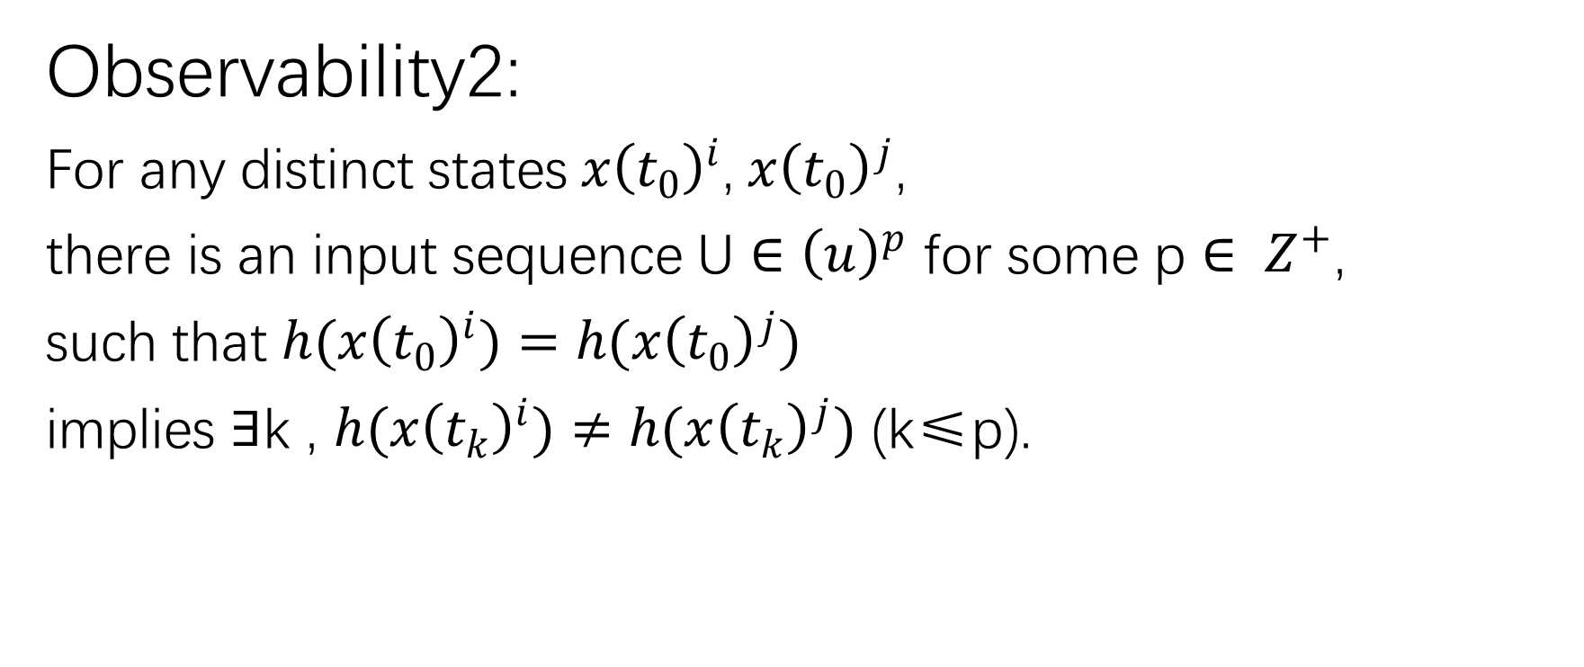
Four Observabilities of BCNs
Observability2:
For any distinct states$x{\left(t_{0}\right)}^{i}$,$x{\left(t_{0}\right)}^{j}$,
there is an input sequence U $∈$ ${\left(u\right)}^{p}$ for some p $∈ Z^{+}$,
such that $h(x{\left(t_{0}\right)}^{i})=h(x{\left(t_{0}\right)}^{j})$
implies $∃$k , $h(x{\left(t_{k}\right)}^{i})≠h(x{\left(t_{k}\right)}^{j})$ (k≤p).

Slide 11
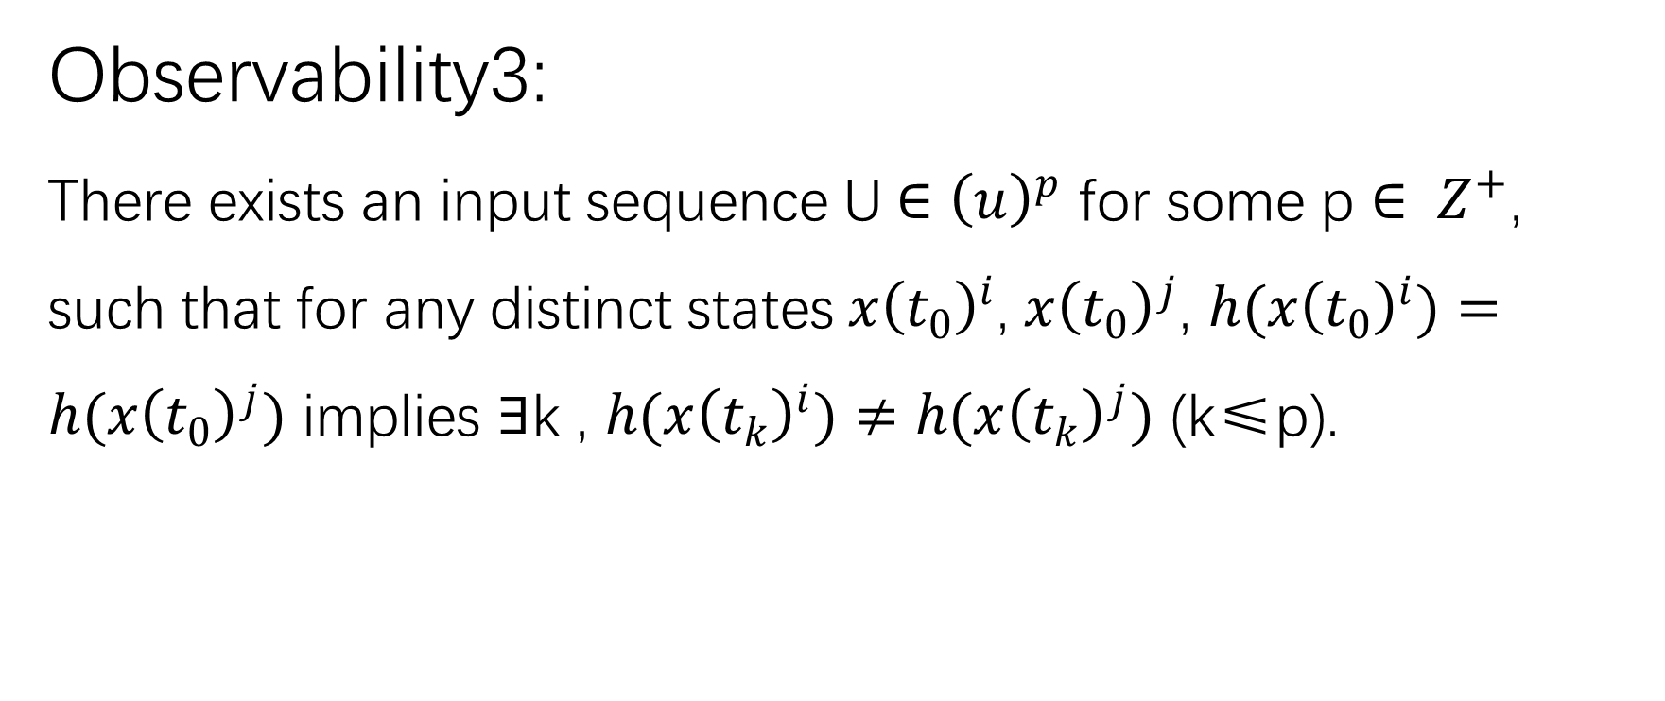
Four Observabilities of BCNs
Observability3:
There exists an input sequence U$∈$ ${\left(u\right)}^{p}$ for some p $∈ Z^{+}$, such that for any distinct states$x{\left(t_{0}\right)}^{i}$, $x{\left(t_{0}\right)}^{j}$, $h(x{\left(t_{0}\right)}^{i})=h(x{\left(t_{0}\right)}^{j})$ implies $∃$k , $h(x{\left(t_{k}\right)}^{i})≠h(x{\left(t_{k}\right)}^{j})$ (k≤p).

Slide 12
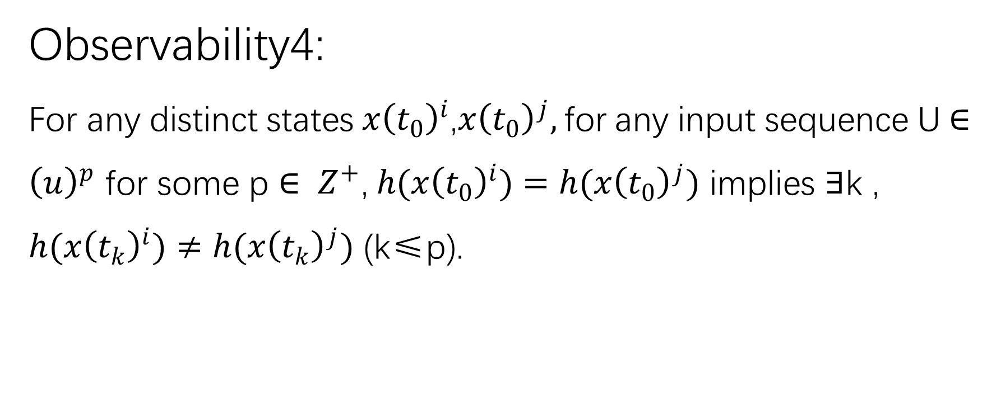
Four Observabilities of BCNs
Observability4:
For any distinct states$x{\left(t_{0}\right)}^{i}$,$x{\left(t_{0}\right)}^{j},$for any input sequence U$∈$ ${\left(u\right)}^{p}$ for some p $∈ Z^{+}\text{,} h(x{\left(t_{0}\right)}^{i})=h(x{\left(t_{0}\right)}^{j})$ implies $∃$k , $h(x{\left(t_{k}\right)}^{i})≠h(x{\left(t_{k}\right)}^{j})$ (k≤p).

Slide 13
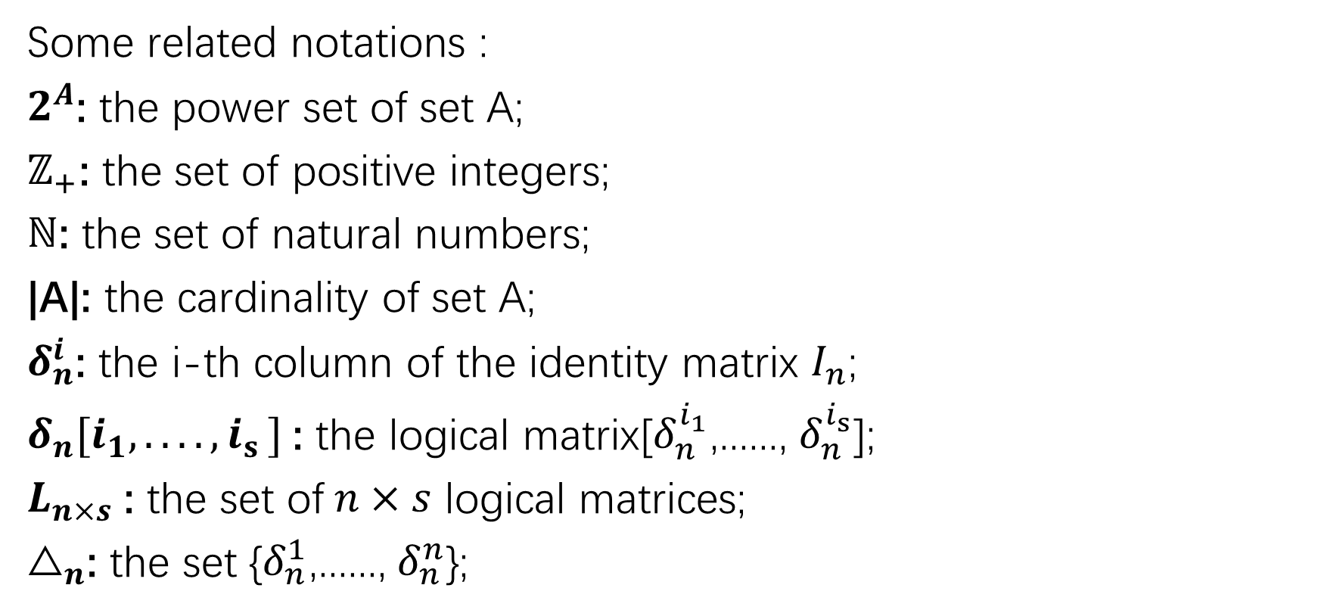
Algebraic Forms of BCNs
Some related notations :
$2^{A}$: the power set of set A;
$ℤ_{+}$: the set of positive integers;
$ℕ$: the set of natural numbers;
|A|: the cardinality of set A;
$δ_{n}^{i}$: the i-th column of the identity matrix $I_{n}$;
$δ_{n}[i_{1},.. .. {,i}_{s}]$: the logical matrix[$δ_{n}^{i_{1}}$,......, $δ_{n}^{i_{s}}$];
$L_{n×s}$: the set of$n×s$ logical matrices;
$△_{n}$: the set {$δ_{n}^{1}$,......, $δ_{n}^{n}$};
Notes:
我们将使用矩阵的半张量积来作为布尔控制网络的代数形式，这些是矩阵半张量积对应的一些基础概念。包括集合的幂集，正整数集合，自然数集合，deta n i表示n阶单位矩阵的第i列，deta n i1 到 is表示由s个deta n i组成的逻辑矩阵。Ln*s表示由逻辑矩阵组成的集合。大deta表示包含n个deta n I 的集合。

Slide 14
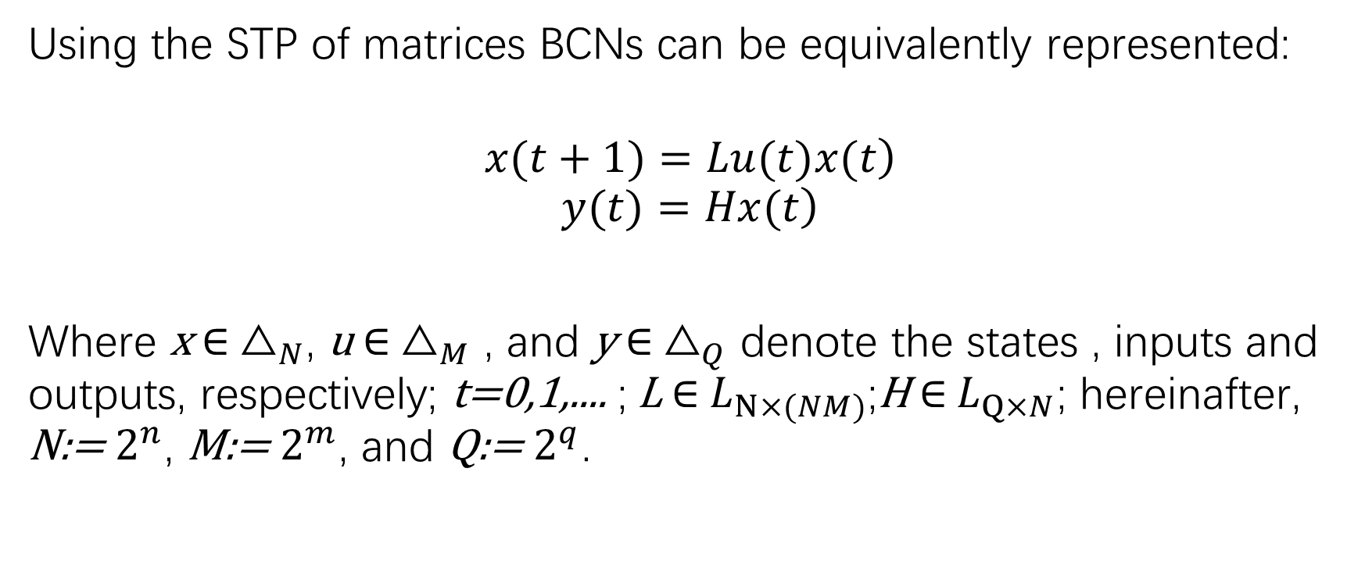
Algebraic Forms of BCNs
Using the STP of matrices BCNs can be equivalently represented:
$$\left.x(t+1)=Lu(t)x(t\right)$$
$$\left.y(t)=Hx(t\right)$$
Where x $∈$ $△_{N}$, u $∈$ $△_{M}$ , and y $∈$ $△_{Q}$ denote the states , inputs and outputs, respectively; t=0,1,.... ; L $∈$ $L_{N×(NM)}$;H $∈$ $L_{Q×N}$; hereinafter, N:= $2^{n}$, M:= $2^{m}$, and Q:= $2^{q}$.

Slide 15
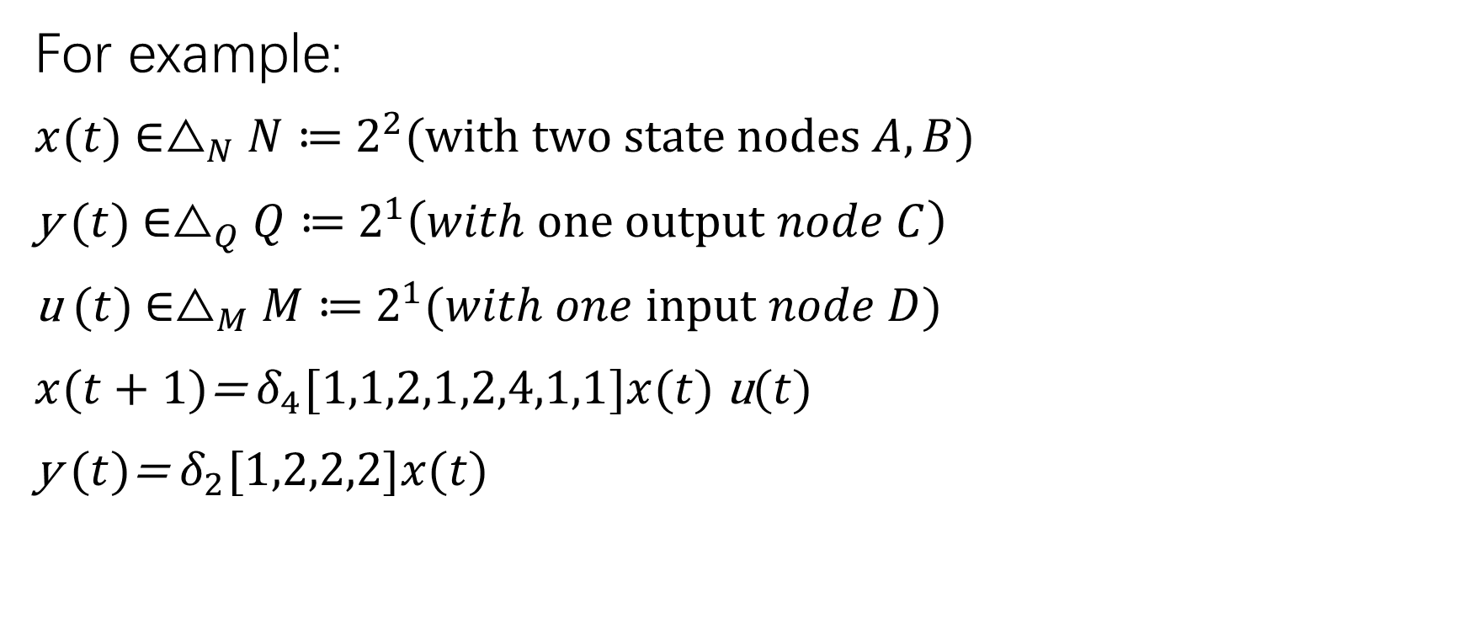
Algebraic Forms of BCNs
For example:
$x(t)$ $∈△_{N}N≔$ $2^{2}(with two state nodes A,B)$
y$(t)$ $∈△_{Q}Q≔$ $2^{1}\left(with one output node C\right)$
u$(t)$ $∈△_{M}M≔$ $2^{1}(with one input node D)$
$x(t+1)$= $δ_{4}[1,1,2,1,2,4,1,1]x(t)$u$(t)$
y$(t)$= $δ_{2}[1,2,2,2]x(t)$

Slide 16
Determine Observabilities by MCMAS
Interaction between various partners in the composition of BCNs.
Environment
Initial states
Observer
Generate and send the input.
Generate and send the output.
Contains multiple nodes
Compare the output.

Slide 17
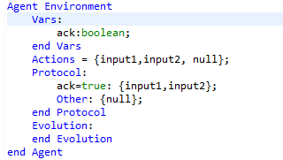
Determine Observabilities by MCMAS
For example
Agent Environment that
generateinput1 or input2
when ack is true, and initialize
the ack as true .

Slide 18
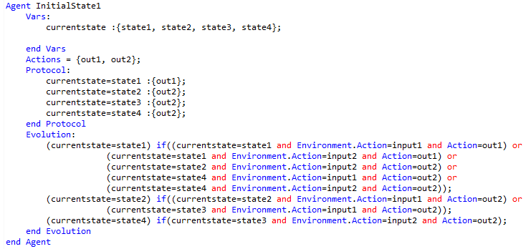
Determine Observabilities by MCMAS
Agent InitialStatei
Initialize its currentstate
as statei, and them
change its currentstate
by input,and generate the output
by currentstate. We have
4 agent InitialStatei.

Slide 19
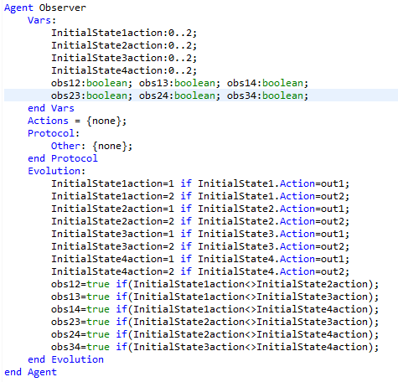
Determine Observabilities by MCMAS
Agent Observer compare
the output of all InitialStates.

Slide 20
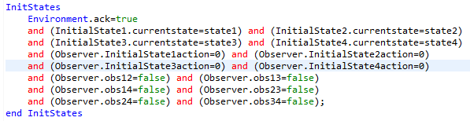
Determine Observabilities by MCMAS
Initialization of all agents.

Slide 21
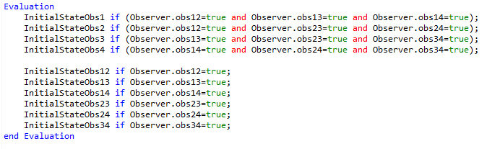
Determine Observabilities by MCMAS
Evaluation we need.

Slide 22
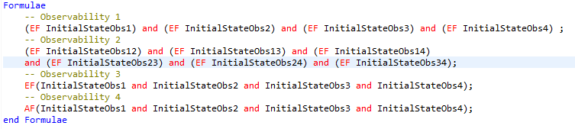
Determine Observabilities by MCMAS
Formulas of 4
Observabilities.

Slide 23
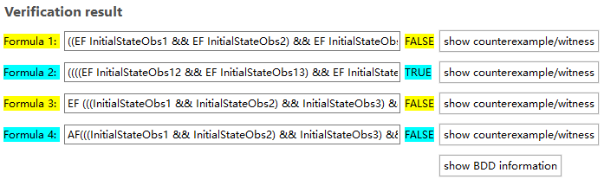
Determine Observabilities by MCMAS
Verification Result

Slide 24
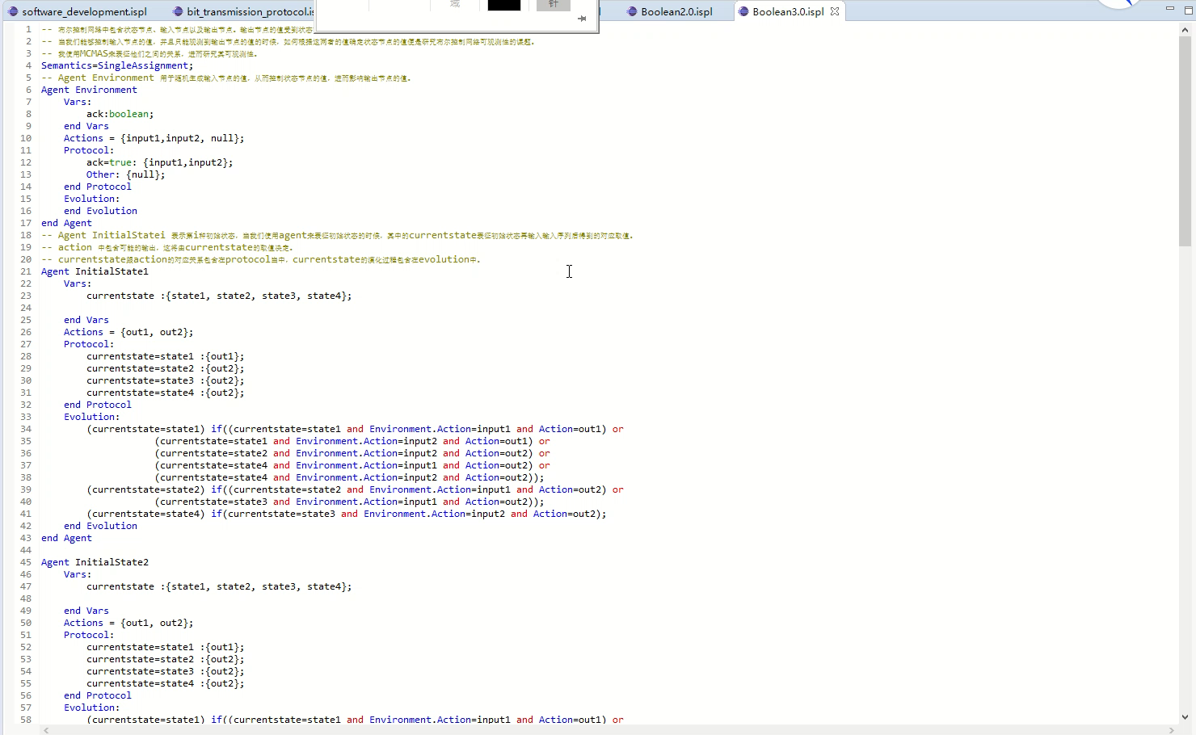
Determine Observabilities by MCMAS

